Slide 1
Artificial Intelligence
School of computer science
Huazhong university of science and technology
冯琪

Slide 2
Tel：13971218355
QQ：1696932867
Email：fengqi@hust.edu.cn（工作）
ai_2019@sohu.com（提交作业&报告）

Slide 3
Lecture 1 Introduction

Slide 4
Outline
Syllabus
Wow AI !
Something you need to know when you want to use AI methods
Intelligent Agent
Features of Problem
Learning: Auto Translation System
Waston

Slide 5
Syllabus
Introduction to Artificial Intelligence – Lecture 01

Slide 6
Topics
Introduction to artificial intelligence
Problem Solving
Knowledge Presentation, Reasoning and Planning
Uncertain knowledge and reasoning
learning

Slide 7
Grading
Homework （20%）
Curriculum report （70%，complete according to the topics）
Attendance （10%)
3 unexcused absences will automatically receive a 10% penalty to the final grade, this penalty will increase by 2.5% for each additional unexcused absence.
Students should notify the instructor in the event of a planned absence

Slide 8
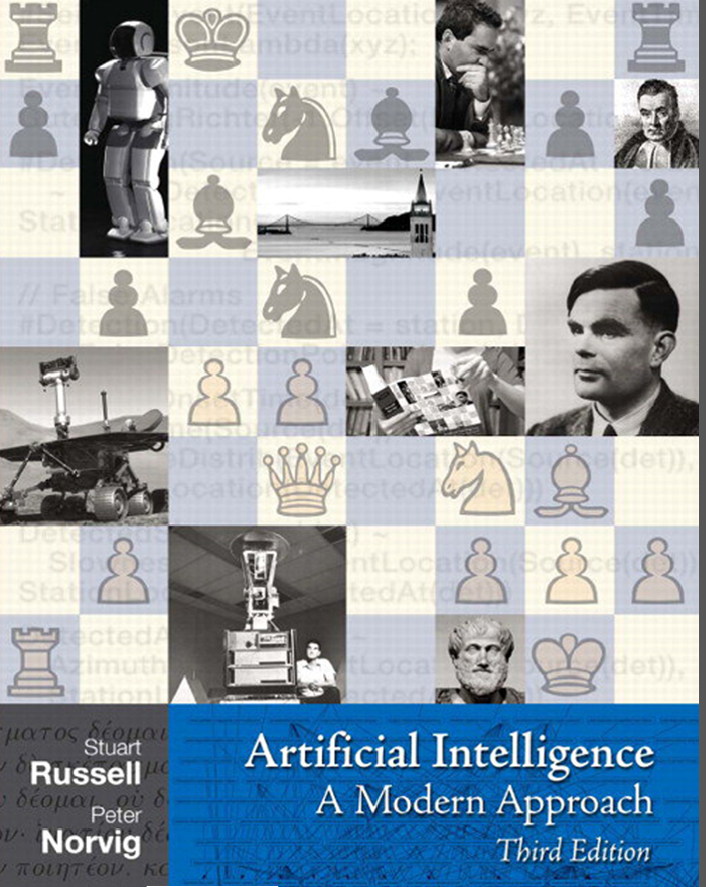
Textbook
Artificial Intelligence
A Modern Approach
Third Edition
Stuart J. Russell and Peter Norvig

Slide 9
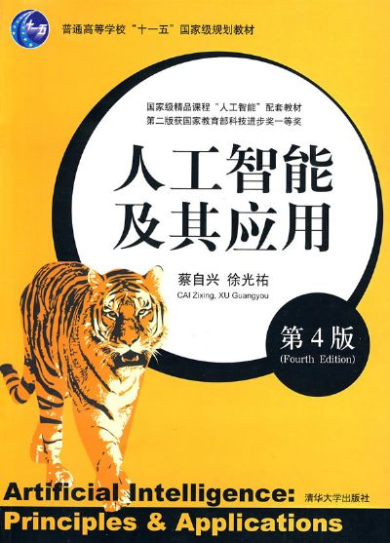
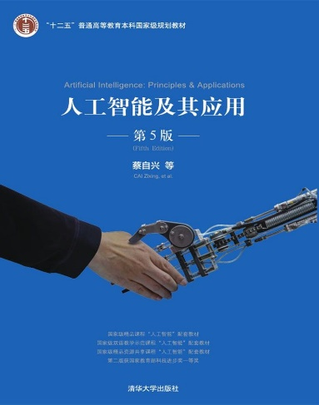

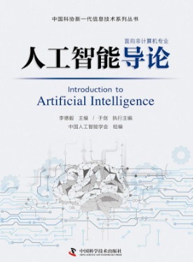
Recommend
王万良
高等教育出版社，2017.7
中国人工智能学会
李德毅、于剑
中国科学技术出版社
2018年8月
蔡自兴，清华大学出版社
第4版（2010.5）
第5版（2016.7）

Slide 10
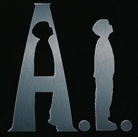
Wow AI !
Introduction to Artificial Intelligence – Lecture 01

Slide 11
Fields
AI is relevant to any intellectual task
General
Learning
Perception
…
Specific
Playing chess ( go chess, …)
Proving mathematical theorems
Writing poetry
Driving a car on a crowded street
Diagnosing disease
…

Slide 12
Different definitions
 | Thinking | Acting
Humanly | to make computers think ...Machines with minds | Machines perform functions like people do
Rationally | Computational models | Rational agent

Slide 13
Cognitive viewpoints
Three mainstream schools
Symbolism（Logicism\Psychologism\Computerism）
---The hypothesis of physical symbol system and the principle of limited rationality
Connectionism（Bionicsism\Physiologism）
---Connection mechanism and learning algorithm between Neural Network
Actionism（Evolutionism\Cyberneticsism）
--- Control theory and perception-action control system

Slide 14
Physical symbol system \ Symbol operating system
Symbol：pattern
A perfect symbol system should have six basic functions
Input
Output
Store
Copy
Establish structure（find out the relationship among symbols）
Conditional transfer（Continue the activity processes according to the existing symbols）

Slide 15
Why can machine simulate human intelligence
If a physical symbol system has all the above six functions and can completed the whole
process, it is a complete physical symbol system.
Both human and computer have these six functions
Hypothesis
If any system can show intelligence, it must be able to execute the six functions.
If any system with the six functions that it could show an intelligent behavior.
---The hypothesis of Physical symbol system

Slide 16
Emphasis of the three schools
Symbolism：Functional simulation
Connectionism：Structural simulation
Actionism：Behavior simulation

Slide 17
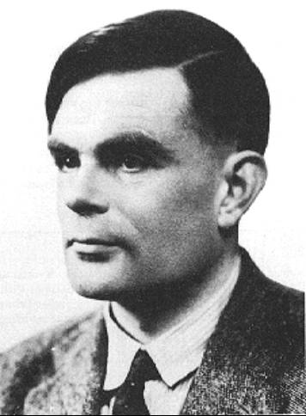
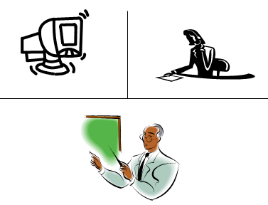
Acting humanly: Turing Test
to provide a satisfactory operational deﬁnition of intelligence(1950)
Conversation
Via online typed message
program and an interrogator
5 mins
Intelligence
Interrogator guesses if the conversation is with a program or a person
Passed if the program fools the interrogator

Slide 18
Acting humanly: computer need to possess :
natural language processing
to enable it to communicate successfully in English;
knowledge representation
to store what it knows or hears;
automated reasoning
to use the stored information to answer questions and to draw new conclusions;
machine learning
to adapt to new circumstances and to detect and extrapolate patterns

Slide 19
Acting humanly: total Turing Test
Turing’s test deliberately avoided direct physical interaction
the so-called total Turing Test
the interrogator can test the subject’s perceptual abilities ;
To pass the total Turing Test, the computer will need :
computer vision to perceive objects,
robotics to manipulate objects and move about

Slide 20
AI: Weak vs. Strong
Weak AI
Can machines act intelligently ?
Strong AI
Can machines really think ?

Slide 21
The Foundations of Artificial Intelligence
Philosophy
Mathematics
Economics
Neuroscience
Psychology,
Computer engineering
Control theory and cybernetics
Linguistics

Slide 22
THE STATE OF THE ART
Robotic vehicles
Speech recognition
Autonomous planning and scheduling
Game playing
Spam ﬁghting,
Logistics planning
Robotics
Machine Translation

Slide 23
Something you need to know when you want to use AI methods
Introduction to Artificial Intelligence – Lecture 01

Slide 24
Intelligent Agent
Perception – Action Cycle

Slide 25
Terminology
1 Fully vs. Partially Observable
2 Deterministic vs. Stochastic
3 Discrete vs. Continuous
4 Benign vs. Adversarial

Slide 26
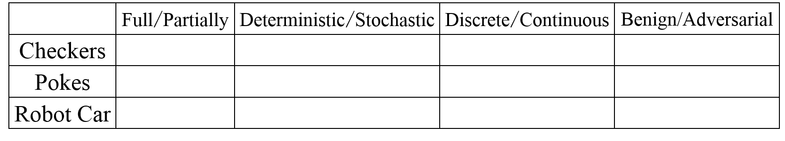
Quiz
☆ The Game of Checkers
☆ Poker
☆ Robotic car
answer
1 Fully or Partially Observable
2 Deterministic or Stochastic
3 Discrete or Continuous
4 Benign or Adversarial

Slide 27
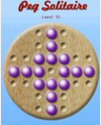
Peg solitaire
1 Fully or Partially Observable
2 Deterministic or Stochastic
3 Discrete or Continuous
4 Benign or Adversarial

Slide 28
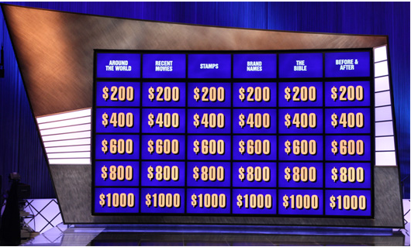
AI in Practice
Watson - DeepQA
Watson is a computer system like no other ever built.
It analyzes natural language questions and content
well enough and fast enough
to compete and win against champion players
at Jeopardy
Jeopardy is a Quiz Show

Slide 29
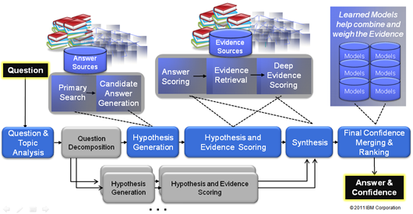
Watson’s answer process for question

Slide 30
Underlying Philosophy - DeepQA
No one program design from top to bottom will have all it needs to understand language
True intelligence will emerge from the development and integration of many different algorithms each looking at the data from different perspectives

Slide 31
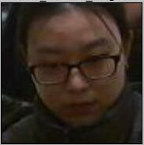
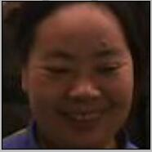

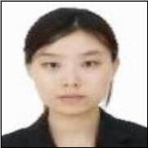

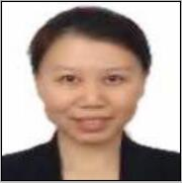
Face recognition
Get some portrait from surveillance camera
The method of deep learning is used to compare with the standard portrait in the database

Slide 32
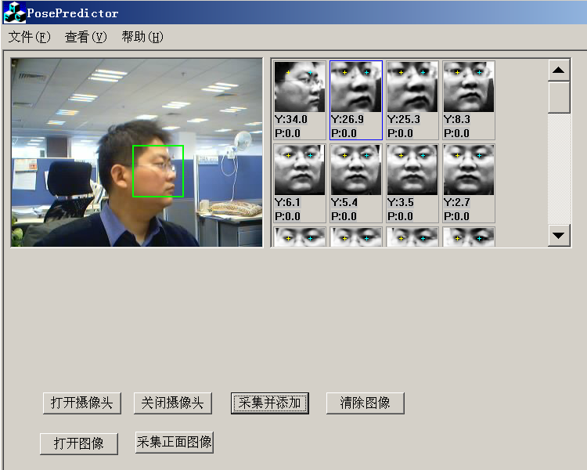
Face pose estimation

Slide 33
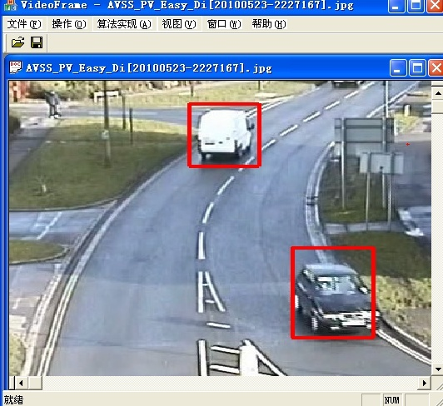
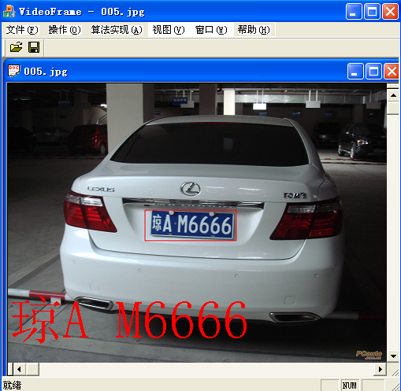
Vehicle detection and license plate location

Slide 34
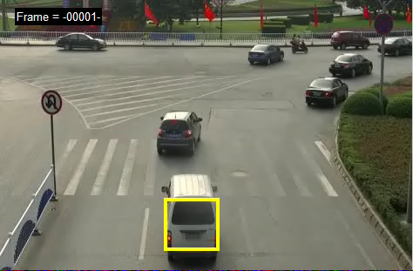
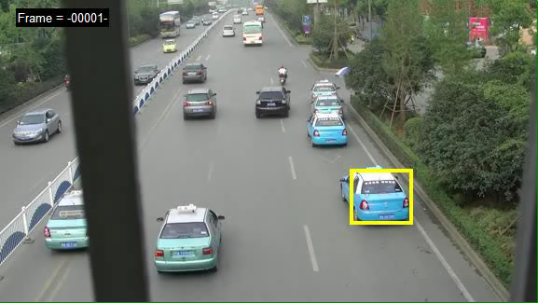
Discrimination of vehicle abnormal behavior

Slide 35
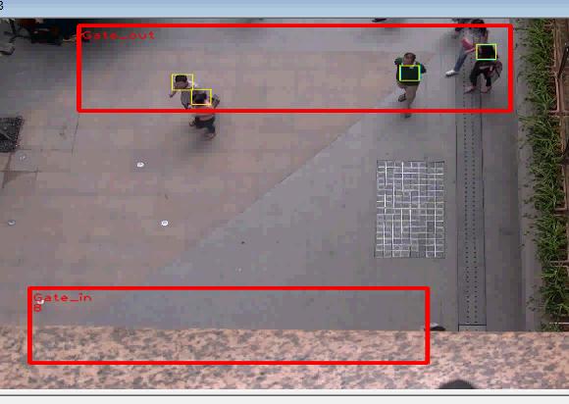
Tracing and Counting

Slide 36
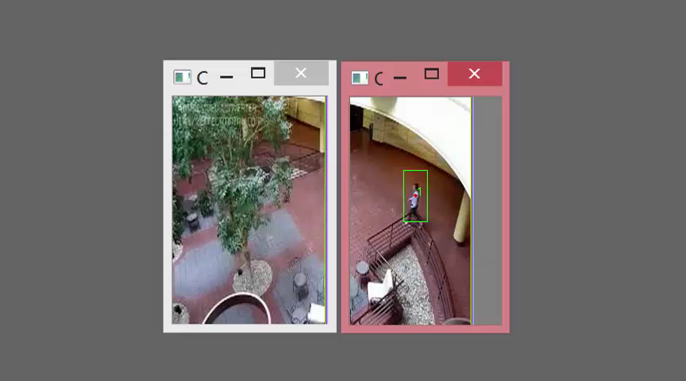
Multi-camera collaboration

Slide 37
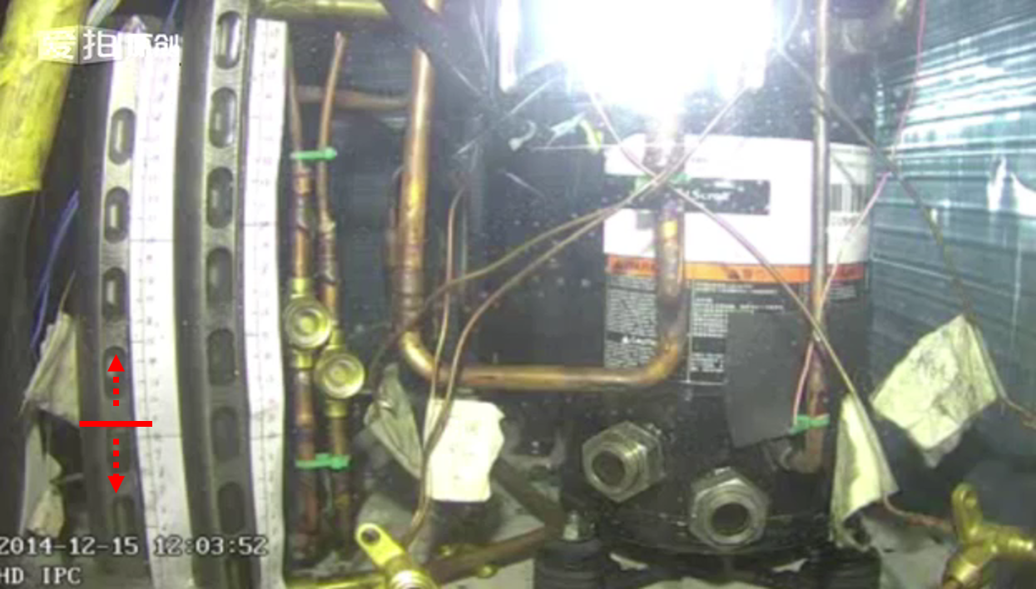
Detection and Tracking for liquid motion

Slide 38
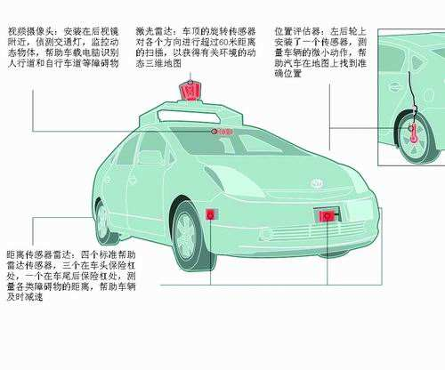
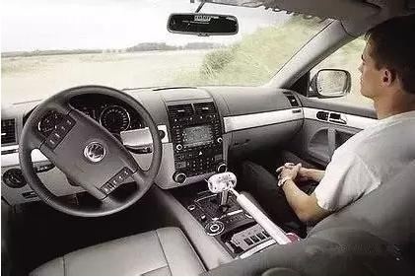
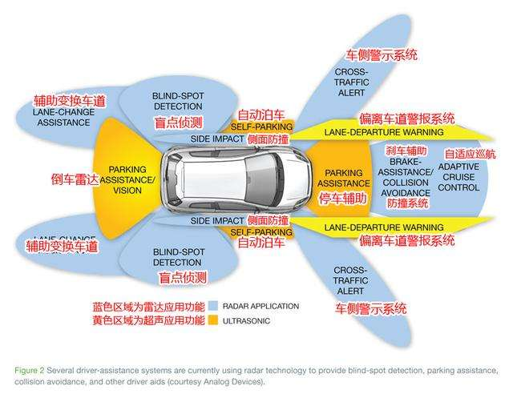
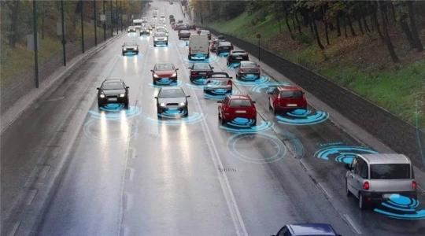
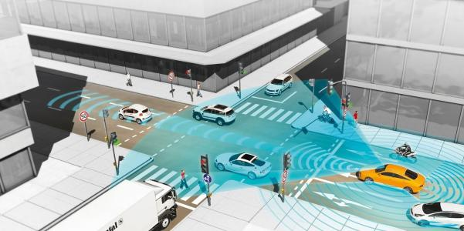
Smart car

Slide 39
Reading for Review
Part1 Chap1 Introduction
All about AI, foundation, History, State of Art
Part1 Chap2 Intelligent Agent
Good Behavior
Nature of Environments

